Slide 1
Working Together: BCHFT as Lead Provider
Laura Brookes
Associate Director of Partnerships

Slide 2
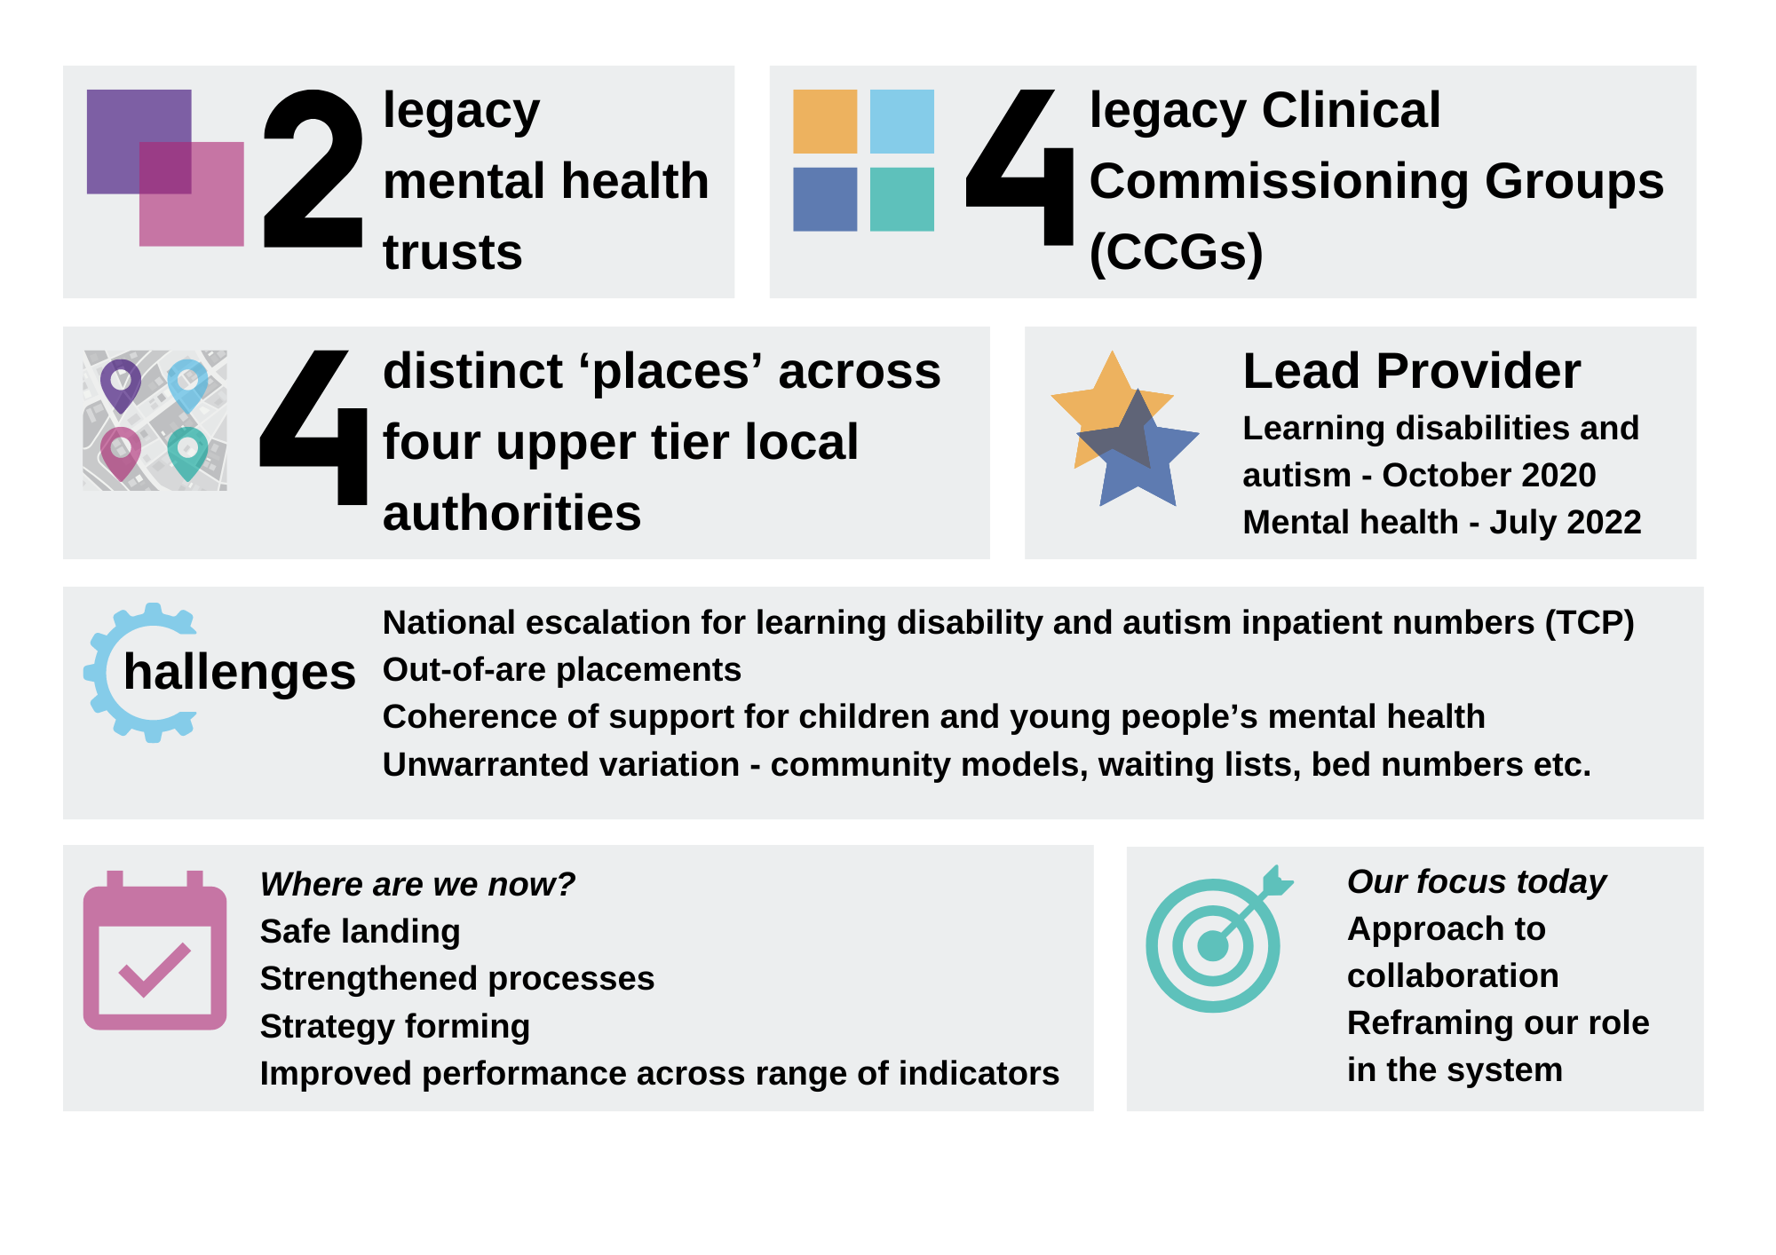
A little bit about us

Slide 3
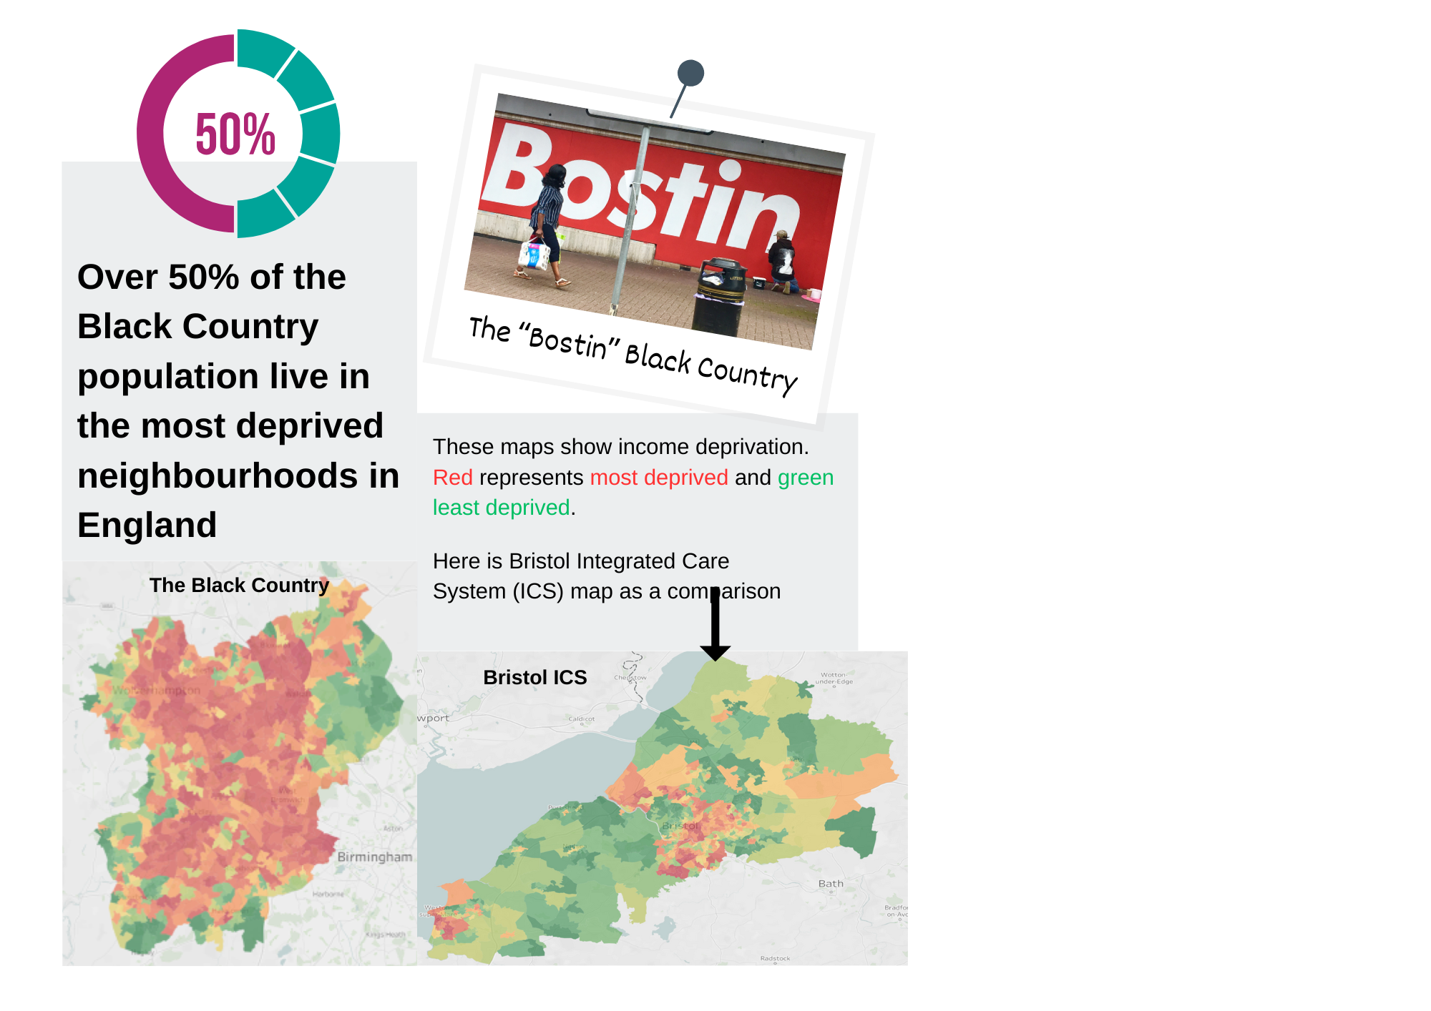
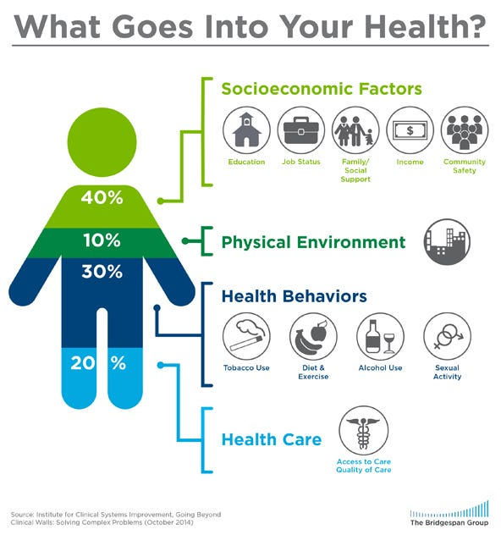
Black Country - proud and resourceful communities…
…but not without challenges
Notes:
The maps above are taken from the VUIT system and demonstrate the difference in deprivation between the Black Country and Bristol. The Black Country is the second most deprived system in the UK and national solutions and models that may have good outcomes in Bristol may not be suitable for the Black Country. The second diagram illustrates the factors that contribute to health outcomes – health care only contributes 20%; the largest impact on someone's health outcomes are socioeconomic factors. So the citizens of the Black Country already face health inequalities based on high levels of deprivation.

Slide 4
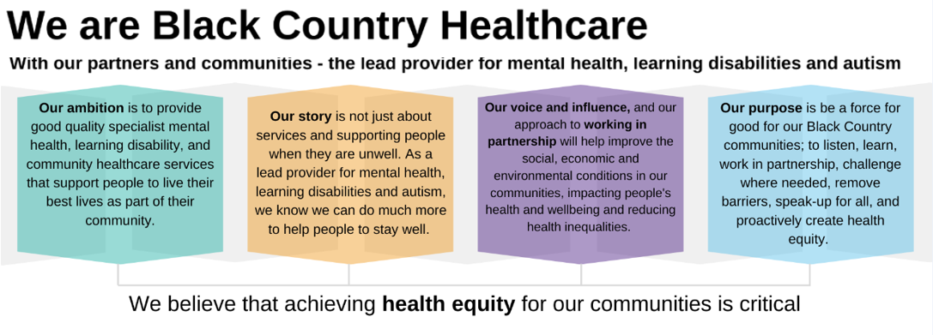

Slide 5
High Impact MH/LDA Priorities through Place –
Priority | Overview | What’s happening
Mental Heath Prevention, Promotion & Health Equity | Building local intelligence across the lifespan (including MH needs assessments and community engagement) to inform a more coordinated and informed approach to service development and resource allocation. | Welfare Rights Programme Wider Determinants of Health Programme Talking Therapies Plus model
Suicide Prevention | Each Place based partner to be actively involved in the development of a Place Based Suicide Prevention plan that recognises that a higher proportion of people that complete suicide are not known to MH services. Collectively progressing holistic and systematic approaches to improving the mental health and wellbeing of local people as a joint priority including raising awareness of suicide, encouraging help-seeking behaviour amongst high risk groups and tackling the social, health and economic factors that increase suicide risk. | Black Country Suicide Prevention Strategy by end Q3
Physical Health of SMI and LDA cohort | A coordinated programme across partners that not only meets the health targets (e.g. for physical health check completion or vaccination) but also offers pro-active intervention and explores preventative opportunities to improve and prioritise access for these at risk groups. Roll out of national ‘Reasonable Adjustments’ requirements for LDA cohort across all health and care partners. | Pilots to improve uptake of health checks Working on the “So what”
Dual Diagnosis | Increasing integration across mental health services and place-based substance misuse services to avoid people falling through gaps, providing more seamless pathways and development of workforce skills and competencies. | Pilot in Walsall to ‘bridge the gap’
Children and Young People’s Emotional MH and Wellbeing (Getting Advice) | Building common understanding and coherent and resource-efficient advice and signposting mental health and wellbeing support for children, young people and families, and specifically those who need support for usual challenges but are struggling to navigate them independently with the usual ‘thriving’ support. Note – we would like to avoid duplication of the existing governance established locally for this priority through the CYP Emotional MH and Wellbeing Boards – see next slide. | Embedding the I Thrive model
Integrated community mental health pathway | Increasing the range of preventative and early help mental health interventions delivered through the voluntary and community sector close to local communities Embedding more seamless pathways and shared care arrangements across primary care and secondary mental health services Making every contact count | PCMH teams Working towards integrated MDTs including MH
Reducing unnecessary mental health admissions / delays | Developing a coordinated approach to providing support for housing, homelessness and those with no recourse to public funds Jointly developing high intensity service user model (HISU) across each place (already in Wolverhampton) | No. of MH inpatients who were homeless No. of MH inpatients with no recourse to public funds HISU measures – activity, experience and A&E attendance
Building local relationships and networks across professionals | Networking opportunities to continuously improve working relationships across multi-agency professionals Developing opportunities to share learning and provide operational feedback locally across professionals/teams Opportunities to share changes and transformation plans across professionals/teams Building joint intelligence (data) and communications systems/channels | Qualitative feedback
Enablers | Estate - Developing opportunities to locally co-locate services to improve access and productivity Workforce - Developing local recruitment campaigns and promoting health and care as a career choice

Slide 6
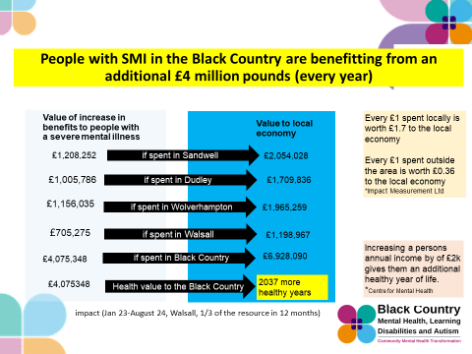
Impact pf welfare rights programme:

Slide 7
Wider Determinants of Health:
Interventions that support those living in the most deprived neighbourhoods locality (we can provide information on this if organisations are not sure)
Interventions that promote access to support for people that have previously been underserved by services (Black, Asian & Ethnic Minorities, Refugee & Migrants, Women from the most deprived areas, Traveller communities)
Interventions that support the 80% of factors that impact on health outcomes that are not clinical care:
Education & employability (ESOL, Maths & English courses, etc)
Welfare rights, housing and socio-economic support
Access to green space and activities that promote physical health
Mental wellbeing activities – think about the 5 ways to wellbeing
Interventions that promote social connection & community
£800k in 23/24 and £800k in 24/25 across all 4 localities.

Slide 8
Sandwell
Lead – Communities in Sync
Members of Communities In Sync (CIS):
• Ideal For All
• Sandwell African Caribbean Mental Health Foundation
• Kaleidoscope Plus Group
• Sandwell AGE UK
• St Albans Community Association
• Breakthru CIC
• Beat It CIC
• Black Country YMCA
Members of Sandwell Consortium
• Bangladeshi Women’s Association
• Brushstrokes Community Project
• Community Connect Foundation
• Ileys Community CIC
• Smethwick Youth & Community Centre
• Skills Work Enterprise & Development Agency (SWEDA)
Just Straight Talk
European Welfare Association
Life In The Community CIC

Slide 9
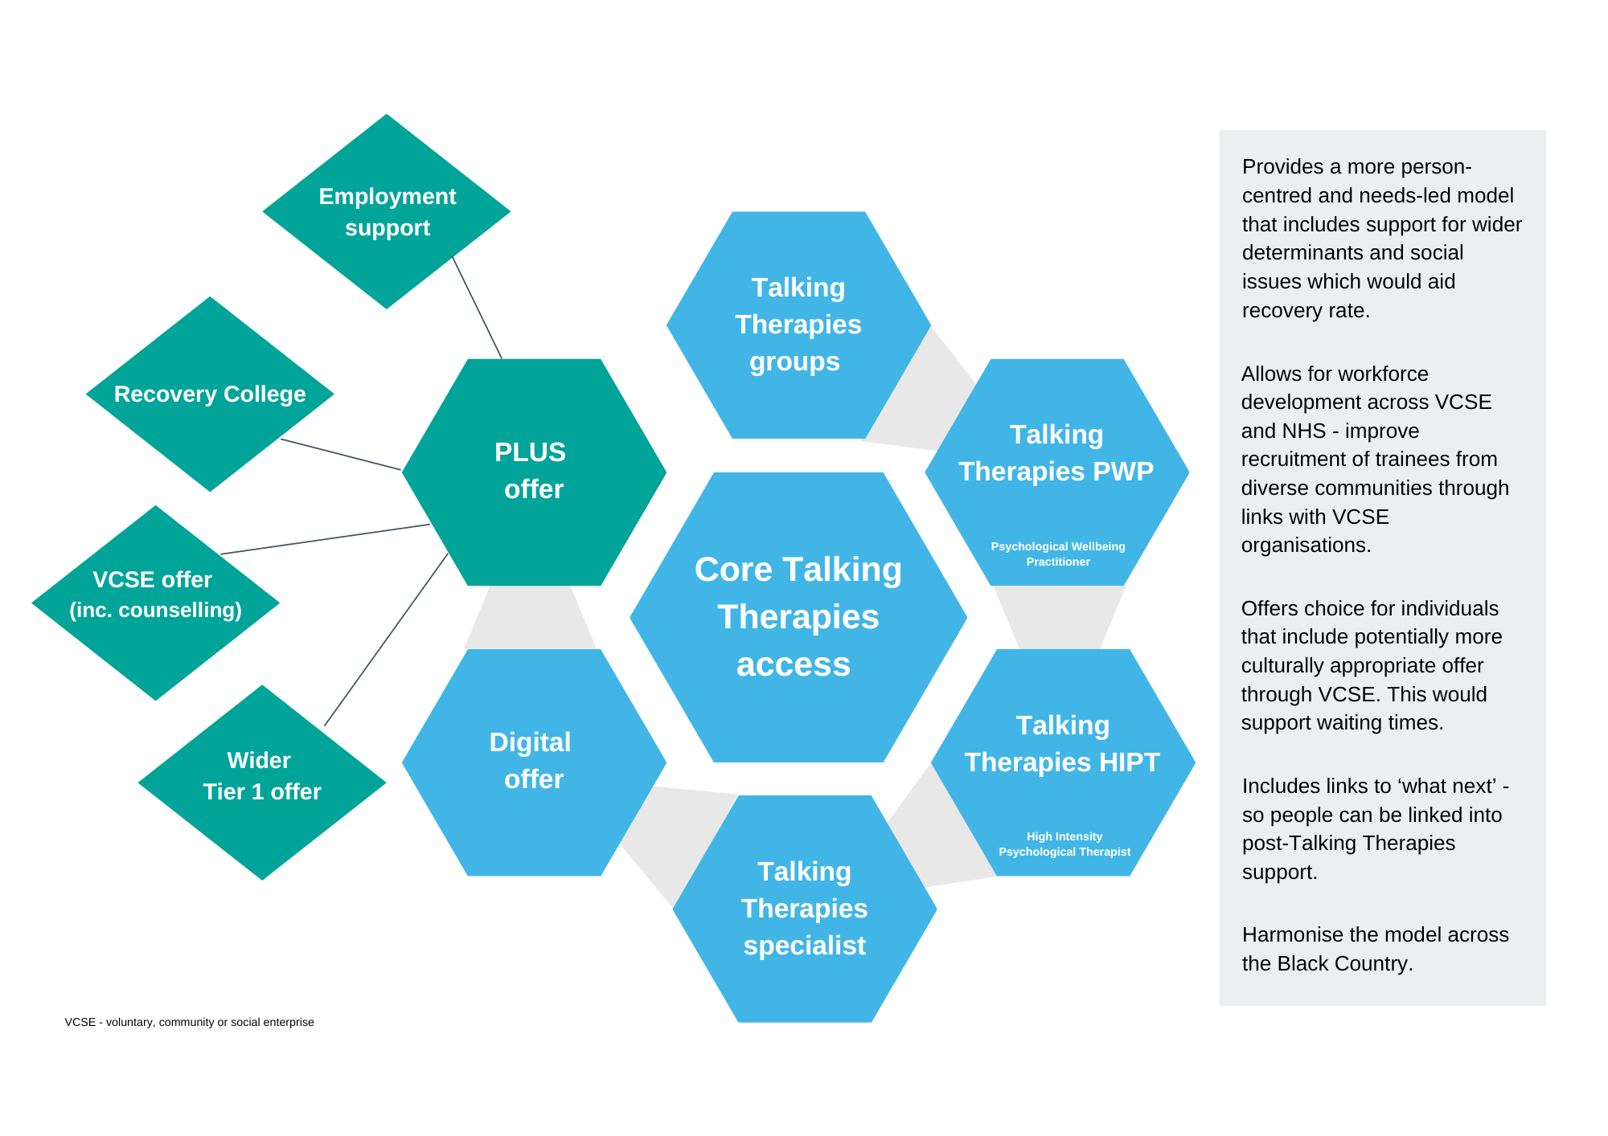
Reframing our offer to communities –
Developing a Black Country model for Talking Therapies
Notes:
As a system we have redesigned our Talking Therapies offer to expand it beyond the traditional NHS Talking Therapies model in order to provide a more holistic approach that provides both talking therapies and support for the wider determinants.

Slide 10
What will the plus offer add?
A complementary, flexible and creative approach to delivering talking therapies. This will include counselling that may not be NHS Talking Therapies Manual compliant but will still be expected to demonstrate effective clinical outcomes. The therapies will be specifically targeted to those communities that have previously been underrepresented in Talking Therapies or who have not seen outcomes comparable to White British users (Black, Asian and Minority Ethnic Groups; Refugees & Migrants; LGBTQ+, Older Adults, Deaf & hearing impaired, men). The service will provide access to therapists with a range of language skills and match users to therapists with the same background.
Supporting those who need to access Talking Therapies but are currently unable to. This may include linking in with the Tier 1 Wider Determinants of Health offer to provide digital training & access, providing trusted advocacy or pre-Talking Therapies preparation or building trust and confidence between NHS services and previously underserved communities.
Ongoing support for users of Core and Plus offer via access to ongoing community support.
£270k per locality from 24/25 funding.

Slide 11
Sandwell
Lead – Communities in Sync
Kaleidoscope Plus Group
European’s Welfare Association
Sandwell African Caribbean Mental Health Foundation
Breakthru CIC
Life in Community CIC

Slide 12
Thank you!
Any questions?

