Slide 1



















Mental Health Commission
A Year On - Progress Report

Slide 2

Overview
Progress Report - A Year On
In 2023, the West Midlands Mental Health Commission was convened to assess the impact that the coronavirus (COVID-19) pandemic had had on the mental health and wellbeing of the West Midlands population, and to understand what action could be taken regionally to respond to those impacts.
Outlines the scale of the challenge through regional prevalence of mental ill health and the conditions in which residents are born, work and live
Celebrates progress made against the recommendations as examples of good practice.
Sets out future opportunities, outlining what more we can do in the WMCA

Slide 3
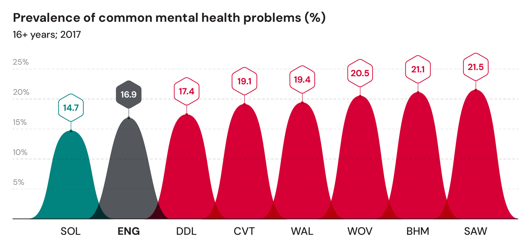
Prevalence of Mental Illness

Slide 4
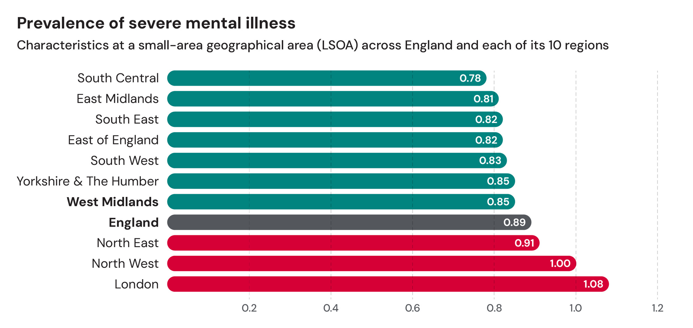
Prevalence of Mental Illness

Slide 5
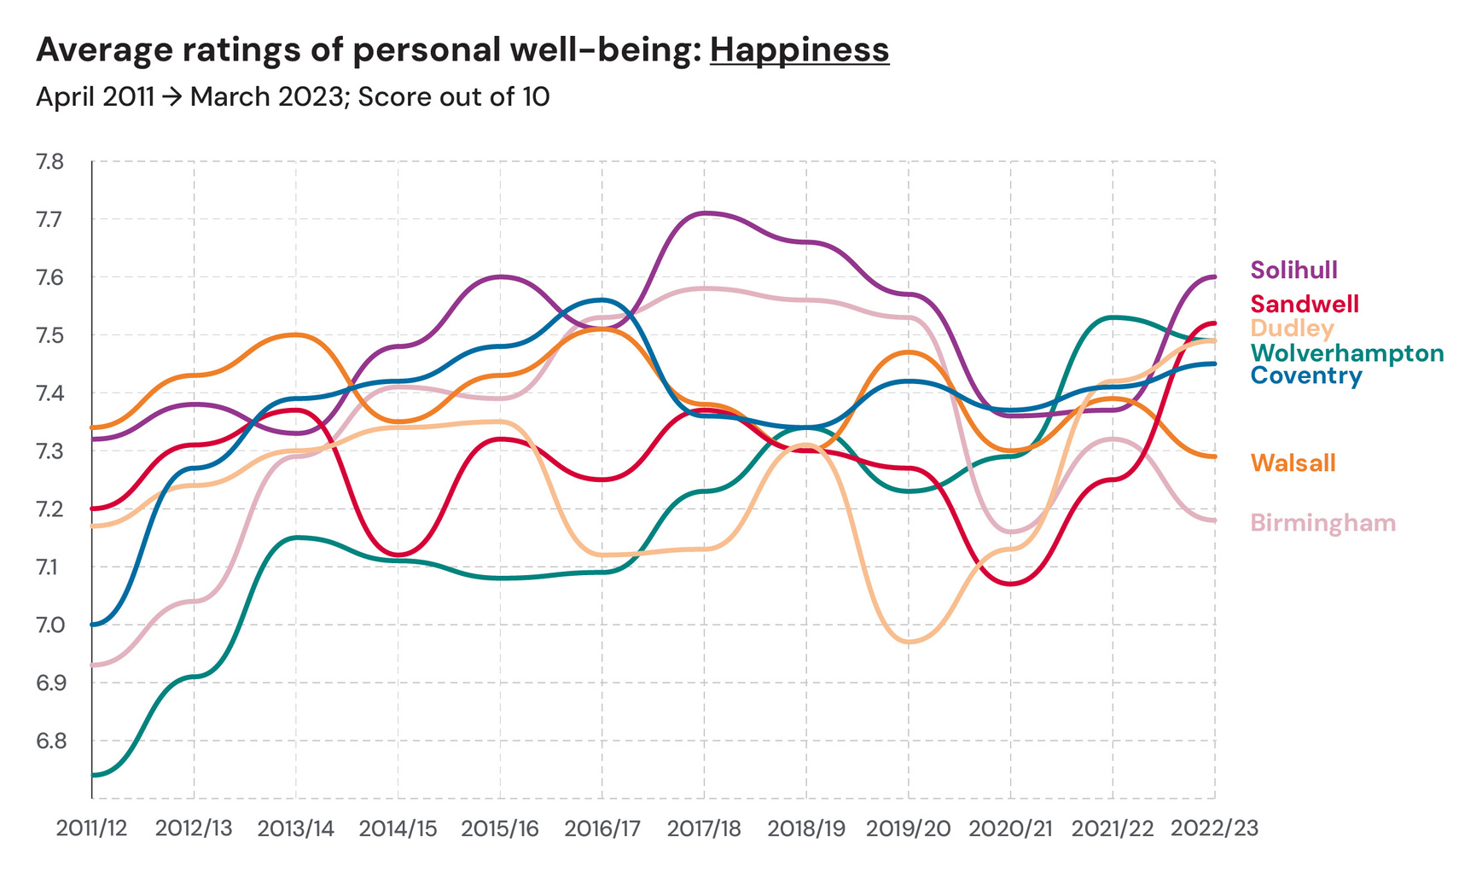
Wellbeing Measures

Slide 6
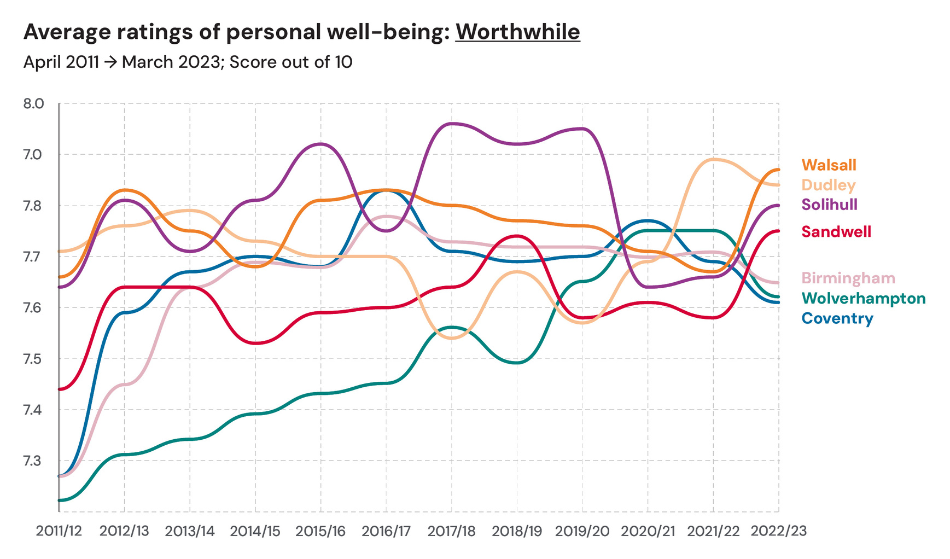
Wellbeing Measures

Slide 7
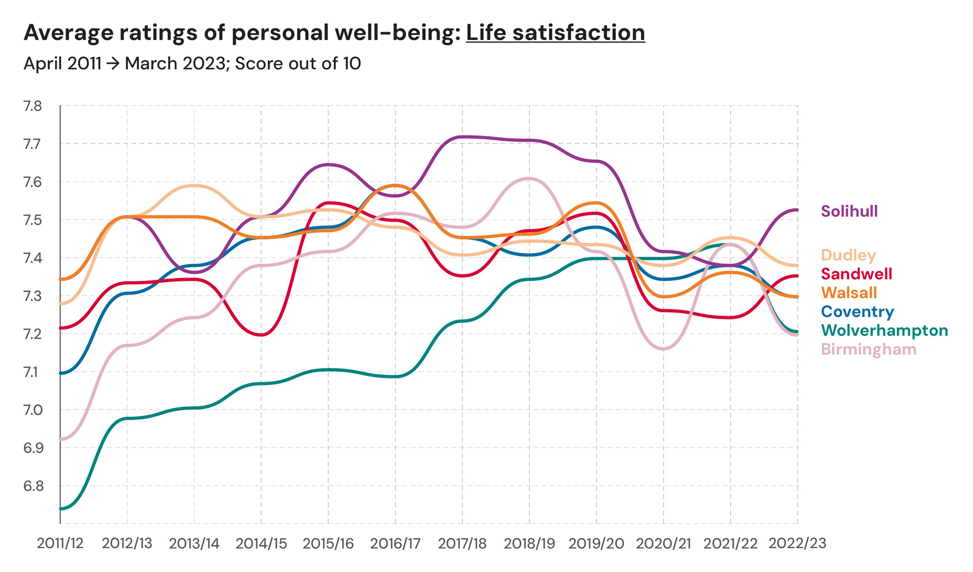
Wellbeing Measures

Slide 8
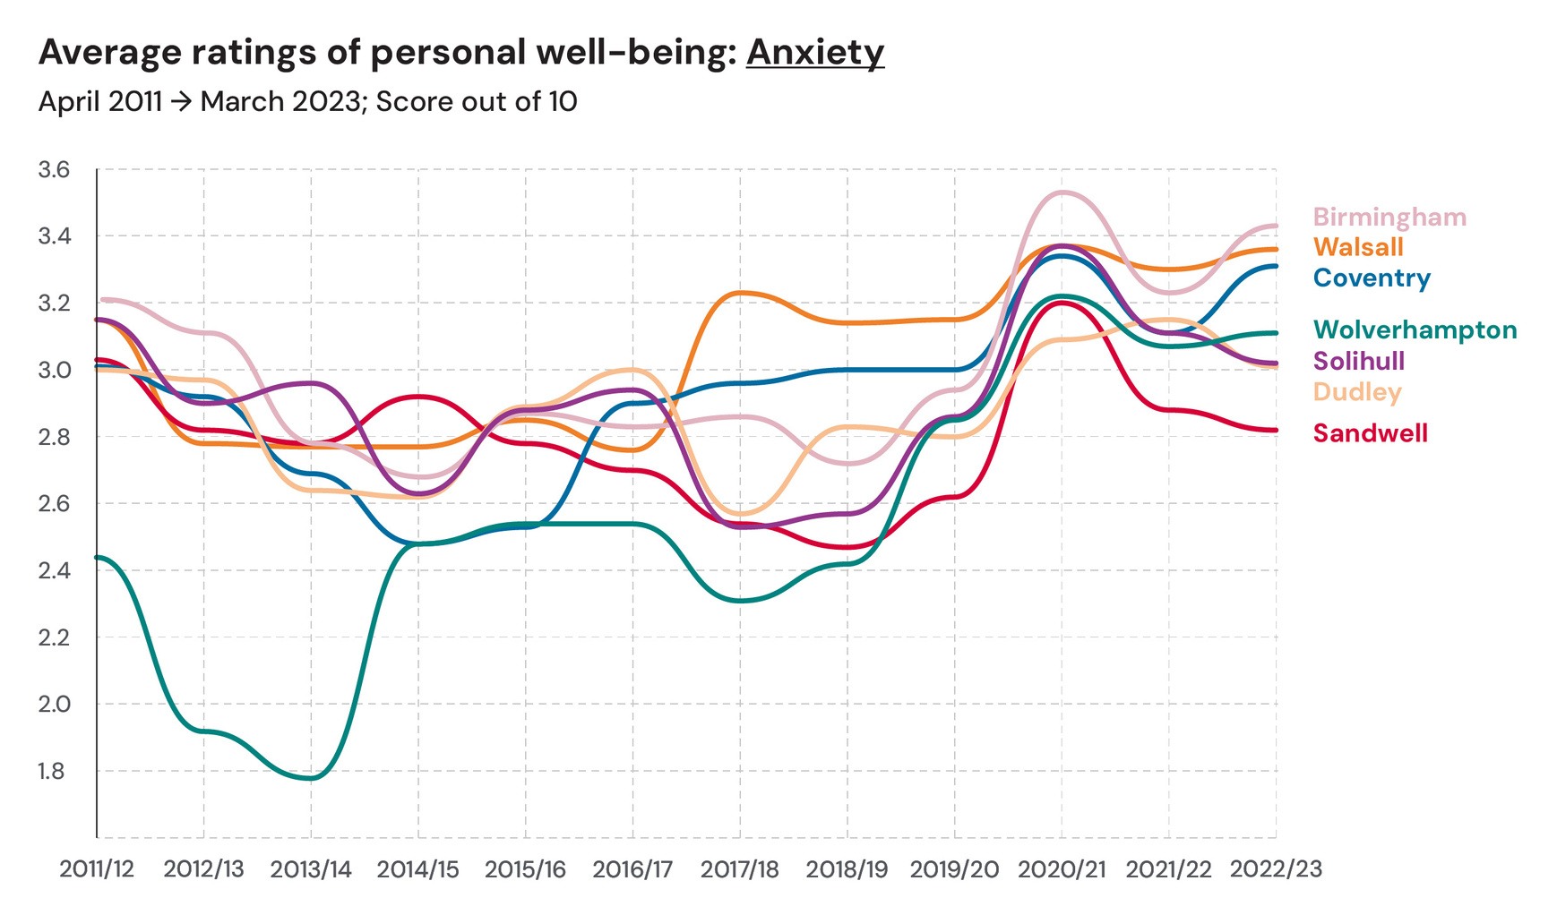
Wellbeing Measures

Slide 9
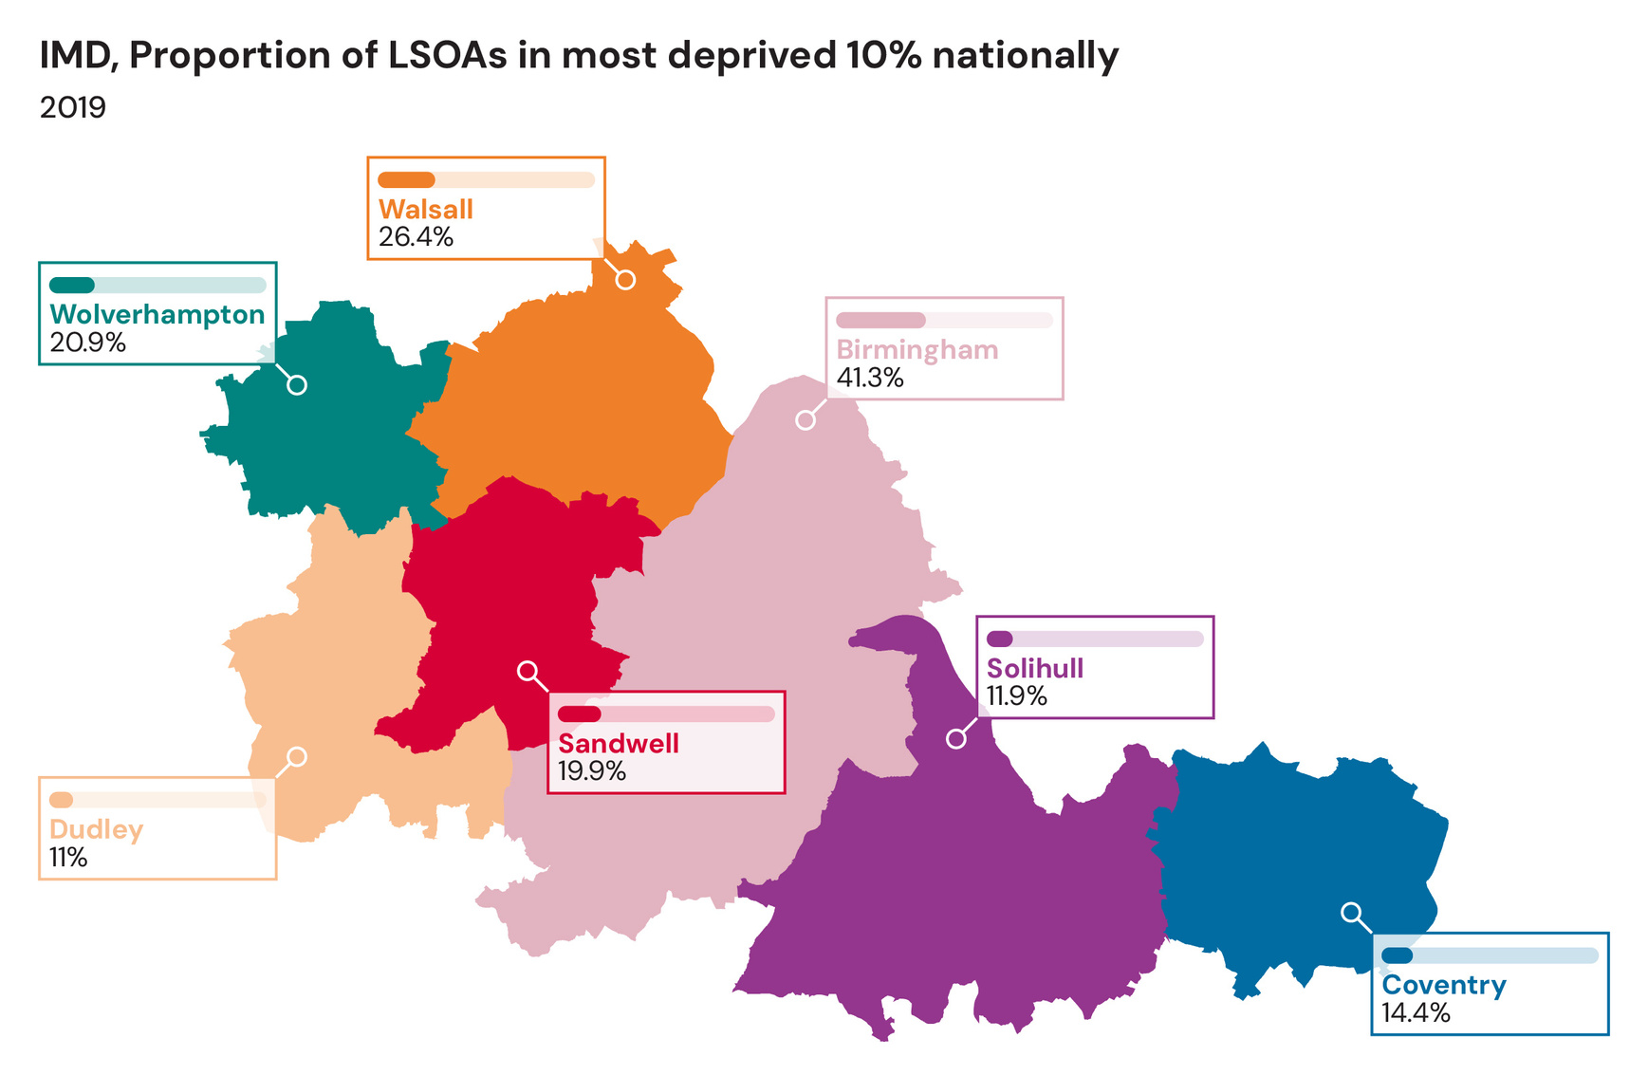
Wider conditions

Slide 10
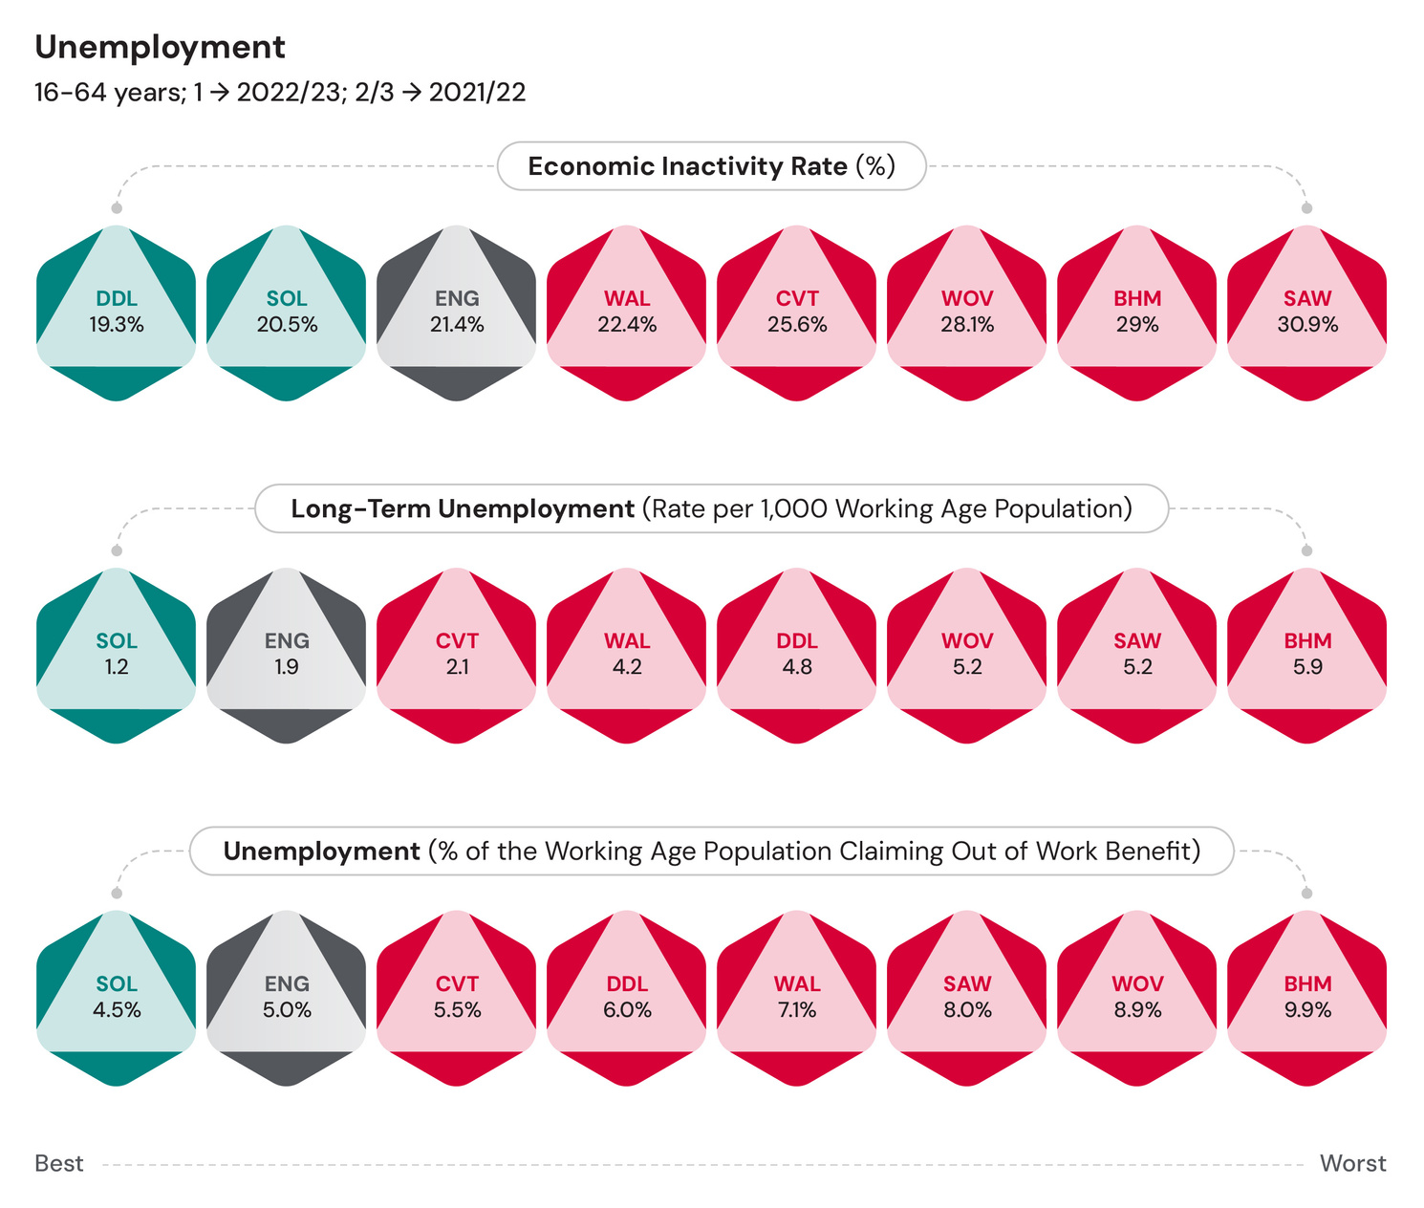
Wider conditions

Slide 11
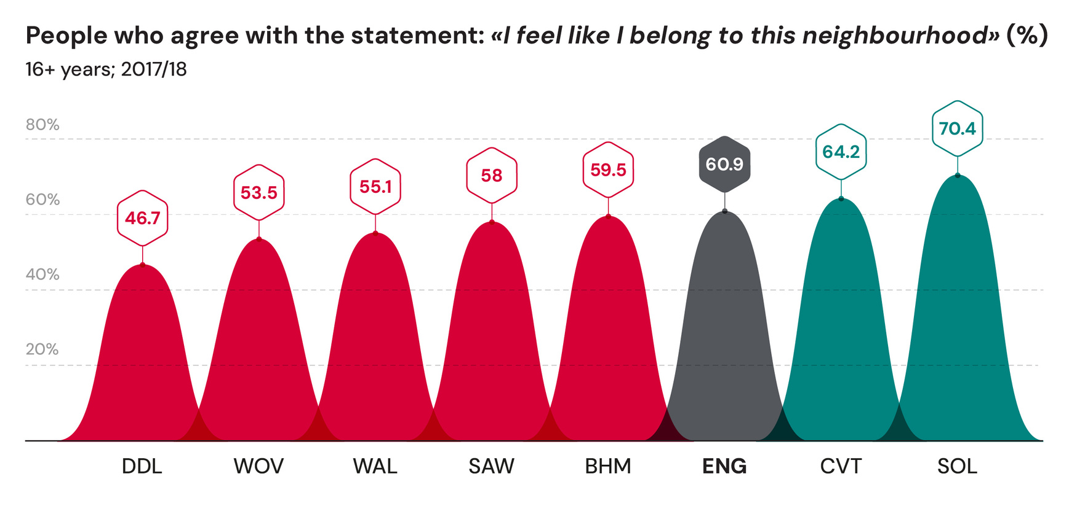
Wider conditions

Slide 12





Progress
The ‘year on’ report reflects on system wide progress against the thirteen recommendations across five thematic areas:
1. Children and young people
2. Mental health and the cost of living crisis
3. Tackling racial inequalities in mental health
4. Sport, exercise, physical activity and mental health
5. Thriving communities and the voluntary and community sector

Slide 13


Children and Young People
The Commission highlighted the importance of childhood in laying the foundations for good mental health across an individual’s lifetime, with four key recommendations for action.
Action
Lead Organisation
Thrive at College
Supporting student mental health and wellbeing
1. Schools and colleges should adopt a ‘whole school approach’ to mental health. This approach should include evidence-based learning about mental health within school curricula and access to counselling and other forms of support alongside the expansion of Mental Health Support Teams.
West Midlands Combined Authority
Family Hubs
Single-branded, high-quality, whole-family, joined up service partnership from before pregnancy to 25 years with a network of hub buildings, outreach and a digital offer.
2. All schools and colleges should work towards zero exclusions. Support for this should include external advice and help for schools to improve behaviour and support children with complex needs including ‘managed moves’ to give students a fresh start.
West Midlands Combined Authority
3. All parents/ carers should have access to and be encouraged to take up evidence-based parenting programmes.
Local Authorities
4. Every West Midlands council area should have an early support hub drawing on the Youth Information, Advice and Counselling Services (YIACS) model or local equivalent.
Local Authorities

Slide 14
Mental health and the cost of living crisis
The Commission outlined a body of evidence indicating financial wellbeing as a major determinant of mental health and the biggest single factor in explaining mental health inequalities, with three recommendations for action.
Action
Lead Organisation
Real Living Wage
Encouraging employers to pay the real living wage, understanding the barriers to doing so as well as exploring collaborative solutions to these challenges.
5. WMCA region should become a ‘Living Wage Place’ with every major public sector body achieving Living Wage Foundation Accredited by 2026 and a region-wide campaign run to get other major employers accredited.
West Midlands Combined Authority
6. Public sector organisations in the region should adopt social value principles in procurement, putting money in the pockets of local people and organisations.
West Midlands Combined Authority
Talking Therapies
Incorporating welfare support into Talking Therapies across the region.
7. Welfare advice should be provided to anyone in the West Midlands using mental health services, including NHS Talking Therapies. This service should include support with personal finances, housing rights, legal issues and employment.
Intergrated Care Boards

Slide 15
Tackling racial inequalities in mental health
Stark inequalities in mental health outcomes and mental health care between ethnic groups were evidenced within the Commission, leading to three recommendations for action.
Action
Patient and Carer Race Equality Framework (PCREF)
NHS Englands first ever anti-racism framework and competence tool.
Lead Organisation
8. The three integrated care systems in the area should support and invest in community-led infrastructure so that they are able to deliver credible and safe mental health support for people from racialised communities in the region. These organisations should be supported to build capacity, form networks for support, and become more sustainable.
Intergrated Care Boards
Inclusive Communities Fund
Belgrade Theatre Trust; producing a play and co-created programme of community engagement activities with a focus on mental health support for black men.
9. The NHS should seek to make the mental health workforce at every level and across all disciplines more representative of the communities it serves.
Intergrated Care Boards
10. ICS Partnerships and ICS Boards should invest in enabling the voice of marginalised communities to inform and be actively involved in decision making and this should explicitly include approaches to enable the voices of people living with mental health issues and with lived experience of these conditions.
Intergrated Care Boards

Slide 16
Sport, exercise, physical activity and mental health
The Commission recognised that physical activity could help prevent and manage mental health problems as a protective factor for mental ill health, with two recommendations for action.
Action
Lead Organisation
Sport England Partnership
WMCA partnership with Sport England to drive infrastructure to support physical activity.
11. Mental health services should provide ready access to physical activity opportunities for anyone who is waiting for support or currently receiving it. Physical activity should be built into treatment ‘pathways’ as a routine element of good mental health care.le and safe mental health support for people from racialised communities in the region. These organisations should be supported to build capacity, form networks for support, and become more sustainable.
Intergrated Care Boards
Improving outcomes for people with SMI
ICB efforts to reduce the difference in life expectancy for people with SMI, utilising social prescribing.
12. The WMCA and local authorities in the region should work systematically to reduce barriers that may prevent local people from engaging in physical activities – cost, lack of culturally appropriate options, transport including traffic, pollution and lack of active travel infrastructure, safety, and the range of activities on offer.
Intergrated Care Boards

Slide 17
Thriving communities and the voluntary and community sector
The Commission acknowledged that community wellbeing is more than the sum of people’s individual wellbeing and that communities that have good mental wellbeing have strong social networks, trust and reciprocity as well as power and control. This resulted in a very important final recommendation for action.
Action
Lead Organisation
Culture Inclusion Network
Bringing grassroots VCFSE organisations serving ethnic minority communities together to meaningfully shape and influence decision-making and service redesign.
13. Integrated care systems should fund and commission voluntary and community sector partners to maximise their sustainability while retaining their independence, flexibility, and creativity. This may mean offering longer-term funding, encouraging provider alliance arrangements between voluntary and community sector organisations, and using grant programmes to support innovation. There is good evidence that voluntary and community sector organisations can deliver better outcomes by tailoring support to diverse communities.
Intergrated Care Boards
Mental Health Collaborative
A cross organisational approach to mental wellbeing including the voluntary sector and those with lived experience at the centre of system wide decision making.

Slide 18




Future Opportunities
Setting out future opportunities and outlining what more we can do in the WMCA
Developing a West Midlands Mental Health Commission Legacy ‘community of practice’
Becoming a Marmot Region, setting a benchmark for health equity
A committment to HiAP and a system wide focus on physical activity through the publication of Health of the Region
Working alongside the Young Combined Authority and Race Equality Taskforce to drive further change and reduce mental health inequality

