Slide 1

Mental Wellbeing in the Workplace
Natalie Morrison, Wellbeing Specialist
Notes:
Intro
World Mental Health Day & theme 'It is Time to Prioritise Mental Health in the Workplace'

Slide 2
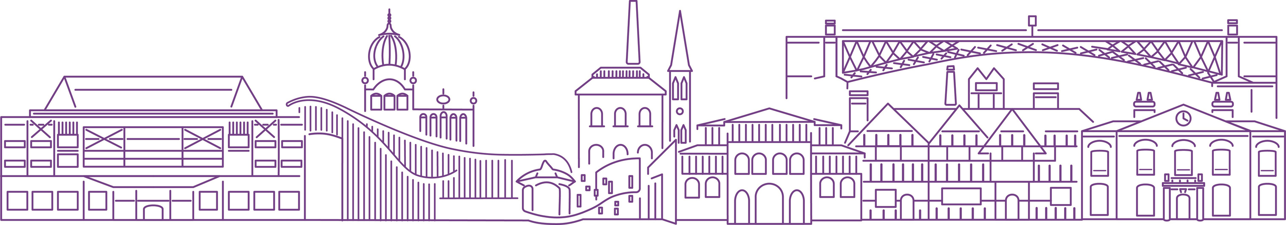
Why is it so important?
Workplace environment is a significant contributory
factor to mind health with three quarters of UK adults
experiencing consequences such as trouble sleeping, stress, lack of confidence & loss of interest
Notes:
AXA UK study shows that poor mind health in the workplace cost the UK economy £102 billion in 2023.
Are we surprised? That day when you’ve had back to back meetings, the day you’ve had meetings with rude or aggressive customers, the pressure being applied to meeting that deadline. If it’s individual days then sure it’s expected or bound to happen but the build up of those occurrences, the culture of your organisation around you, the support or lack of support that you receive too easily can start reaching a level of burnout.
We also know that many studies have shown the positive effects work can have on an individuals mental wellbeing so why wouldn’t we want to build on this?

Slide 3
Benefits to investing in employee wellbeing:
Employee retention
Productivity & performance
Reduced absenteeism
Workplace culture
Legal & Ethical responsibility
Cost savings
Notes:
Significant ROI - Deloitte's return on investment analysis of employee mental health shows on average, for every £1 spent on supporting their people's mental health, employers get nearly £4.70 back on their investment in improved productivity.

Slide 4

‘Wellbeing is not the plaster we stick on a person
once they’ve reached capacity or burn out.
It is the extent to which we keep ourselves in balance
and energised by the work we do, the people we spend
time with and the way we live our lives’
Notes:
Our Sandwell mantra

Slide 5

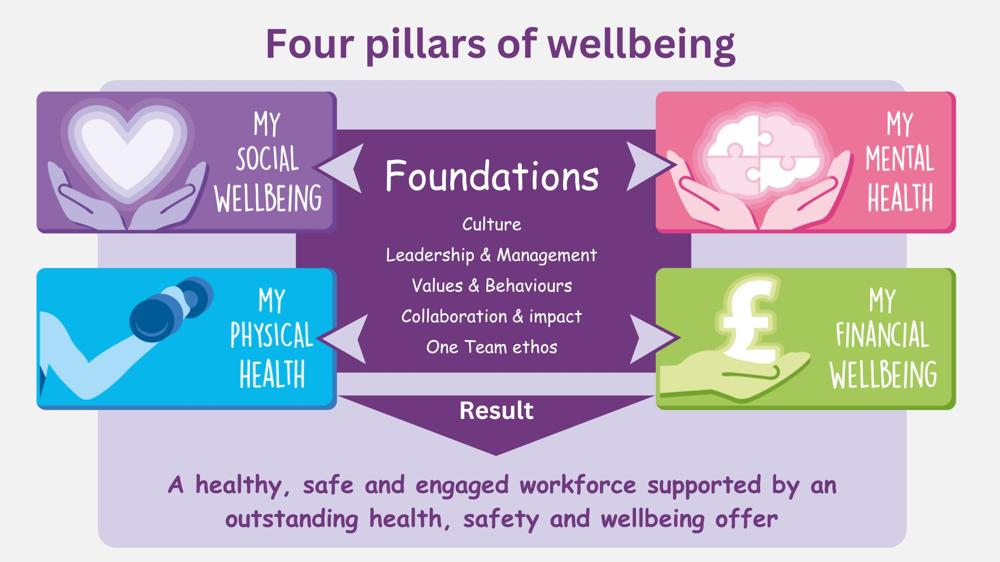
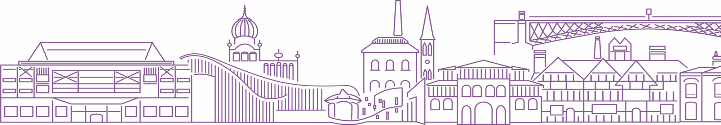
Notes:
Snippet from our Wellbeing strategy. We know that if your metaphorical cup is already full of concerns around financial wellbeing and/or your physical health then it will not take much to ‘overspill’ into mental wellbeing. We therefore take a holistic approach to wellbeing.
Building on crucial foundations

Slide 6

Employee Check-ins
Wellbeing Champions
Dedicated intranet space
Menstruation to Menopause
Physical Wellbeing spaces
Wellbeing calendar & events
ED&I Staff Networks
Notes:
Power of conversations in early detection/prevention
Having dedicated break out spaces away from an individuals workspace has received excellent feedback….micro breaks Employees who take micro-breaks show less fatigue and greater energy and enthusiasm for their work. This is because concentrating for prolonged periods of time depletes the brain and leads to a decline in performance
Supporting our foundations of collaboration, one team ethos passionate group who champion and are the voice for our wellbeing agenda
Our champs support the calendar we have whereby we focus on a dedicated wellbeing area each month..
Somewhere colleagues can go to look for the support available without anyone else needing to know about it
Work closely with EDI – people are bringing their whole, unique selves to work – psychological safety
With 60% of our workforce directly affected by menstruation and/or menopause symptoms and 100% affected in some way; policy, guidance and M2M champions creating an accepting culture, breaking down taboos.
Shared some of the things that we as an employer do to support the mental wellbeing of our staff and yes of course as a large employer we have EAP, mh support BUT the foundations we have discussed, the culture we have in our workplaces don’t cost anything….want to leave you with something that a colleague shared during one of our menopause cafes……

Slide 7
I was going to go off sick… but now I don’t feel alone any more
Notes:
I can go into engagement levels and various data but the power of just taking time to listen, recognise the things our colleagues are going through can reap great outcomes for all

Slide 8


