Slide 1
Sandwell Better Mental Health Strategy 2024-2029
Kate Hickman – Vulnerable Groups Programme Manager
Anna Blennerhassett – Consultant in Public Health
10/10/2024

Slide 2
Overview
Summary of Strategy Development
Consultation
Impact of Consultation
Recommendations
Action Plan

Slide 3
Summary of Strategy Development
Sandwell MBC and partners have been developing this strategy for several years
  COVID 19 pandemic delayed progression – new needs assessment
  Focus on improving population wellbeing and prevention of mental health issues
  Partnership working key to delivery
Final draft approved for public consultation by HWBB September 2023
  Consulted on Autumn/Winter 2023 across wide reach of organisations and people
  Over 500 responses in total
  Strong consensus for support with >80% agreeing with recommendations
Notes:
State of Sandwell consultation and report (2019-2021) helped shape recommendations and current activity to support better mental health
Sandwell Better Mental Health Strategy Group relaunched in 2021 to progress strategy and action plan development.
February 2022 - HWBB approved the development of the Sandwell Better Mental Health Strategy
The final draft was developed by:
Hosting several coproduction workshops with stakeholders
Conducting a rapid needs assessment
Ensuring understanding current issues and impacts of COVID-19.
The final draft was approved for public consultation by the HWBB in September 2023
67 different organisations and 510 residents responded to the consultation

Slide 4
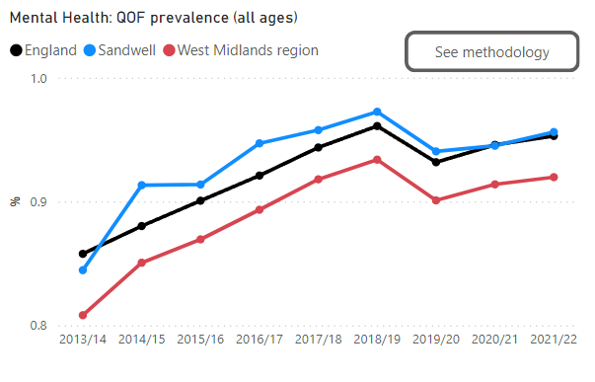
Data on Mental Health in Sandwell
Source: 3.6 Mental Health. Chapter 3 Healthy Living. Sandwell JSNA
Notes:
Sandwell has higher rates of MH disorders in comparison to West Midlands region and England

Slide 5
Public Consultation
The public consultation was launched at a stakeholder event on 26th September 2023 and ran until 13th December 2023.
To ensure a wide reach for the consultation, we:
  Utilised the Sandwell Council online Consultation Hub
  Published consultation surveys (1 x residents and 1 x professional/organisations) and promoted widely across networks, partnerships and communication channels
  Provided translations in a range of languages (Punjabi, Bengali, Polish & Urdu)
  Produced an accessible video explaining the priorities and key drivers of the strategy
  Grant funded community organisations to host consultation focus groups to reach as diverse a range of communities as possible

Slide 6
Public Consultation: Engagement
67 different organisations responded to the consultation
Engaged with a variety of partners including West Midlands Police, SMBC, NHS, schools and a range of voluntary sector organisations incl. faith settings.
510 individuals completed the consultation
This provided comprehensive feedback on content and recommendations
Also provided learning around accessibility and effective engagement with communities

Slide 7
Support for Recommendations
"I feel now more than ever we need easy access to low level community support“
"All...are required to meet the MH issues community groups deal with everyday"
"Because everyone in one time of their lives will need mental health support"​
​
​
"There is a lot of worry about mental health in our communities"​
Why they thought this was the case:
  MH issues are increasing (N=7)
  Particularly post covid (N=8)
  And due to cost-of-living crisis (N=4)

Slide 8
What more would you like Sandwell Better Mental Health Partnership to do to prevent mental health problems and promote mental wellbeing in the borough?
Members of the Public Responses (N=336)
Organisation Responses (N=58)
Notes:
We asked several questions in the consultation including what more could the partnership do to improve overall mental health and wellbeing.
Several key themes emerged.
Interventions for specific communities – included CYP & families, those with English not as first language, elderly, people with different health conditions or impairments i.e. deaf/hard of hearing, house-bound people, LGBTQ.
And specific services such as bereavement support, counselling, activities to reduce isolation

Slide 9
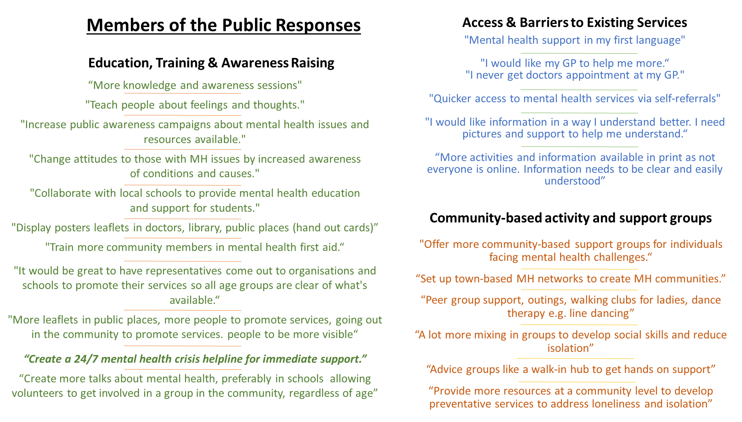
“Create more talks about mental health, preferably in schools allowing volunteers to get involved in a group in the community, regardless of age”

Slide 10
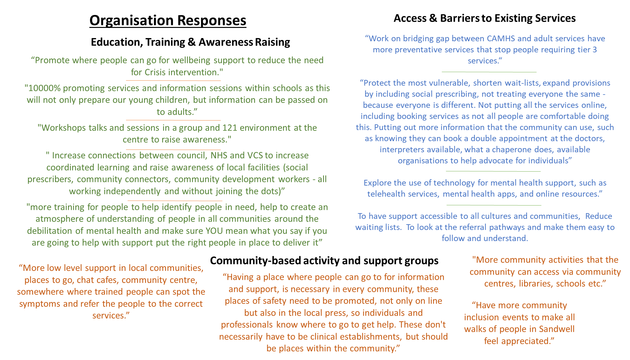

Slide 11
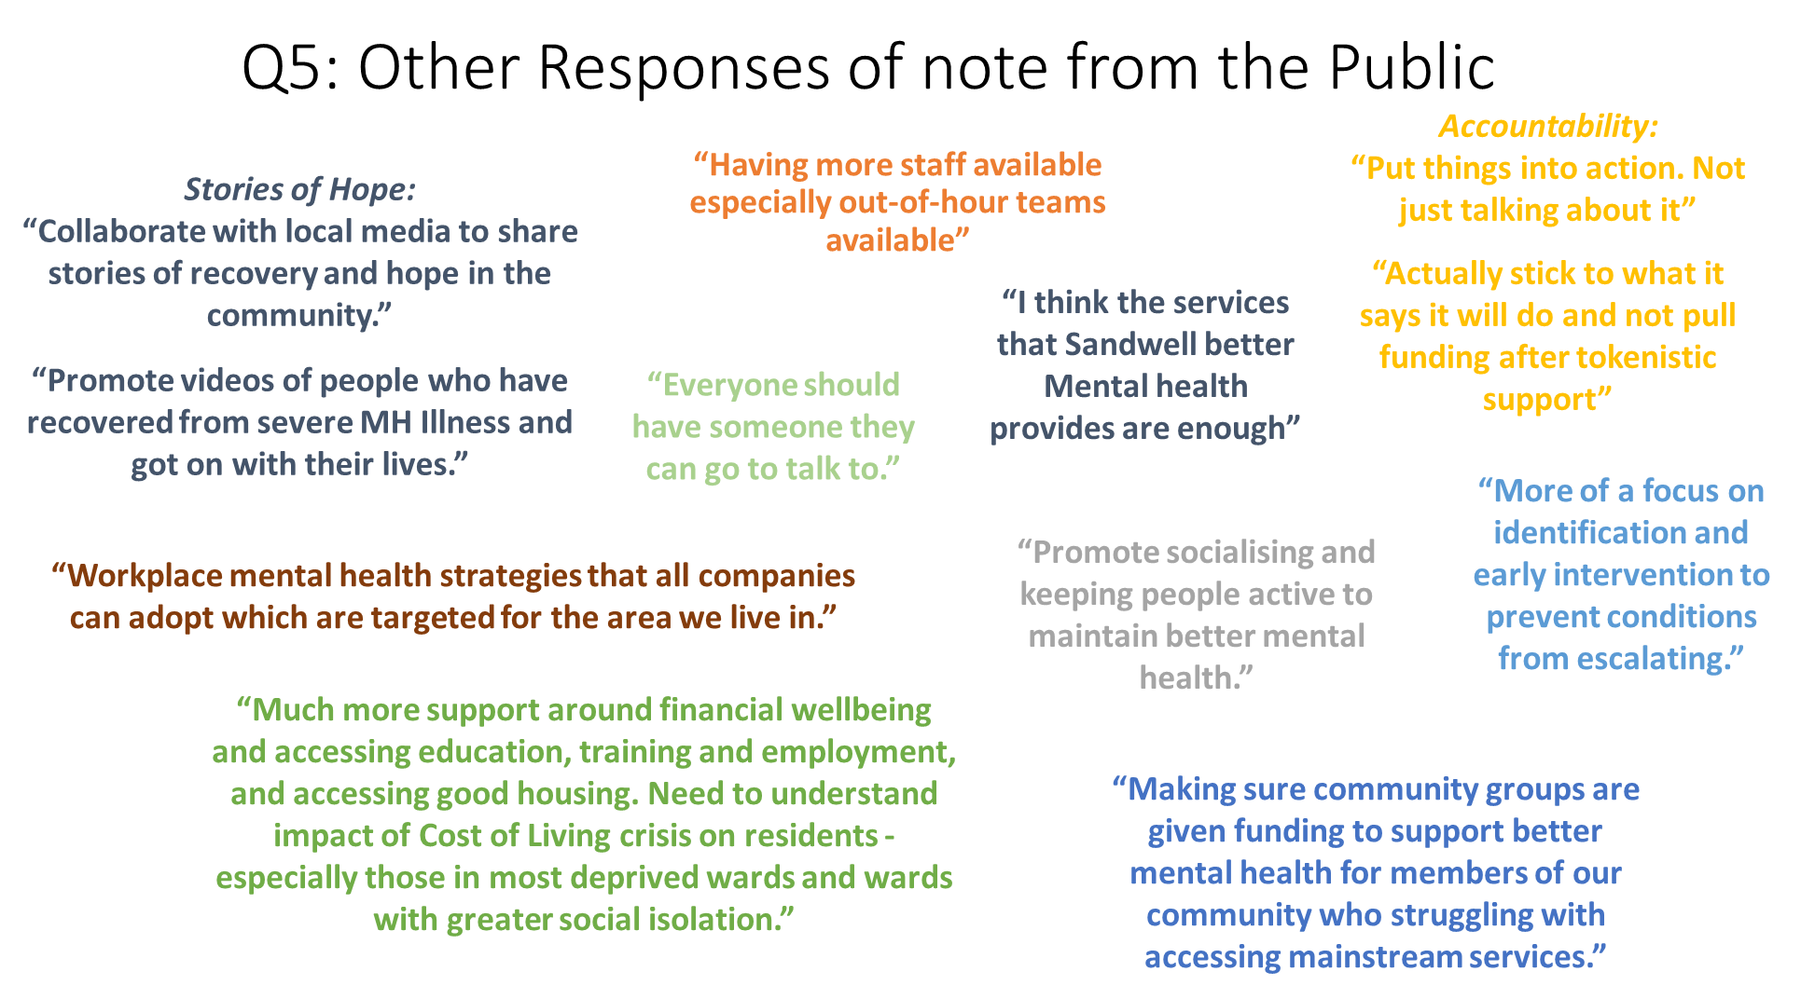

Slide 12
Other Responses of note from Organisations
“Keep listening to your residents and support your VCS to deliver outcomes against this Better Mental Health framework aligning to the proposed strategy. Share the learning to date widely like you have done.….. Please keep it going and embed this further - our Sandwell needs some stability.”
“Consultation is key with all the communities as Sandwell is very diverse, so important to communicate widely. The Partnership need to ensure proper investment is secured to improve mental health problems and promote mental wellbeing, with a focus on BME communities.”
“Keep funding our vital services. This BMH funding for us has supported us to 'unlock' other local funding and continue building on what we have learned so far. We have even used some of the data to lever in a 3 year lottery funded programme.”
“Working with young people and families i feel that resilience is one of the most important things to focus on”
“More mental health awareness and support from employers”
“Tends to fund the same activity based projects by the same organisations. More support needs to be given to organisations that support people 24/7 rather than just during a funded activity slot. Community organisations where volunteers are willing to befriend and support people outside of funding. Support organisations who offer youth work support and a community of support to young people and families.”
“Link organisations together to share best practice and reduce competition when applying for grants or limited funds.”
“More activities for the community and promoting awareness on how to implement a healthier lifestyle.”

Slide 13
Impact of consultation
Main themes for the strategy:
  Education and raising awareness of mental health and wellbeing
  Improving access and addressing barriers to existing services
  Support for community-based activities and support groups
  Interventions for specific communities
  Consideration of resource allocation
  Action on wider determinants affecting mental health and wellbeing

Slide 14
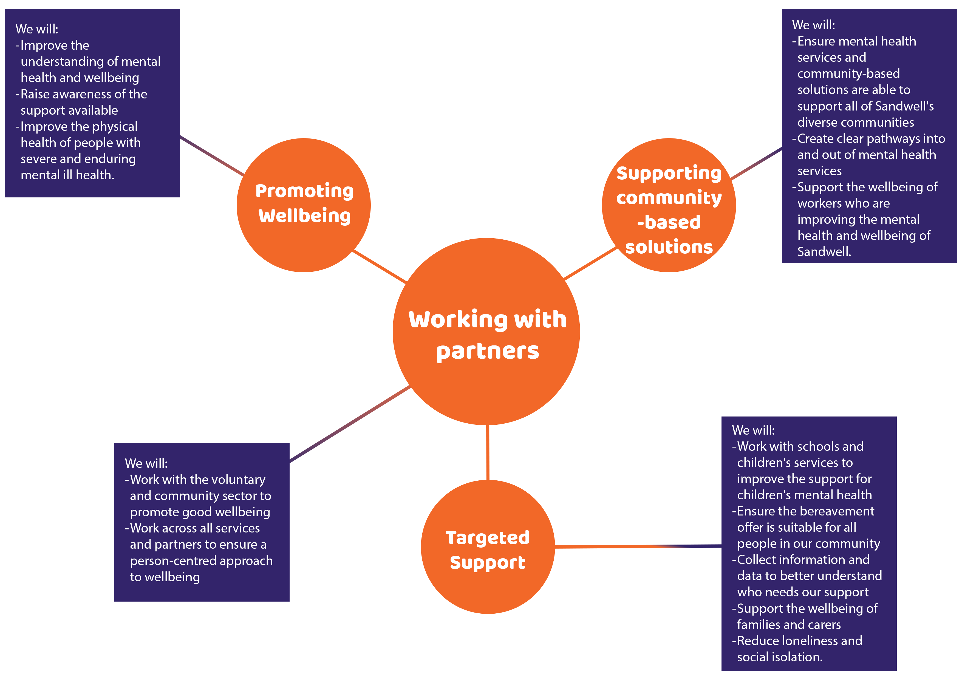
Recommendations
Notes:
12 recommendations ensuring that we are:
Working in partnership
Promoting wellbeing
Supporting community-based solutions
Offering targeted support

Slide 15
Action plan – what we have done
Working with partners
  Established the Sandwell Better Mental Health Partnership
  Co-production in everything we do
Promoting wellbeing
  Mental health training given to 700 professionals and residents
  Communications campaign to increase awareness of services and reduce stigma
Supporting community-based solutions
  Invested almost £1M in Sandwell Better Mental Health Programme
  Grants to community orgs working with ethnic minority communities, men, new parents, carers, young and older people, people who have disabilities, people who are deaf, blind, and the LGBTQ+ community
Targeted support
  Building the local evidence base using a Mental Health Needs Assessment, adding a chapter to the JSNA, and evaluating the Sandwell BMH Programme
  Ensured COVID-19 Recovery funding went to underserved communities
Notes:
Notes – to speak to additional info in strategy action plan.

Slide 16
Action plan – what we will do
Working with partners
  Strengthen the Sandwell Better Mental Health partnership to implement the action plan
  Work with Black Country NHS MH Trust on place-based compact
  Enhance the community wellbeing champions programme
Promoting wellbeing
  Continue with training offer to Sandwell communities and workforce
  New stage of communications campaign to reduce stigma and increase help-seeking
Supporting community-based solutions
  Co-produce a “What does good look like?” framework to inform community offer
  Ensure a sustainable community prevention offer for Sandwell
  Share best practice across partners to ensure high quality programmes available
Targeted support
  Support partners to implement programmes for: Children and Young People, Faith communities, Better Lives for Carers, physical activity for those with Severe Mental Illness, bereavement support, and those who are underserved by MH services
Notes:
Additional info as per strategy.

Slide 17
Thank you for listening
Kate Hickman – Vulnerable Groups Programme Manager
Kathryn_Hickman@sandwell.gov.uk
Anna Blennerhassett – Consultant in Public Health
Anna_Blennerhassett@sandwell.gov.uk

